Slide 1
LMI Data Synthesis Competition
The Warriors Team
Sheng Luo, Xiaochi (George) Li, Xinyu (Mandy) Zhang
The George Washington University

Slide 2
Outline
Exploratory Data Analysis (EDA)
Data Preprocessing
Autoencoder Data Synthesis
Model building
Linear Regression
XGBoost
Final Output

Slide 3
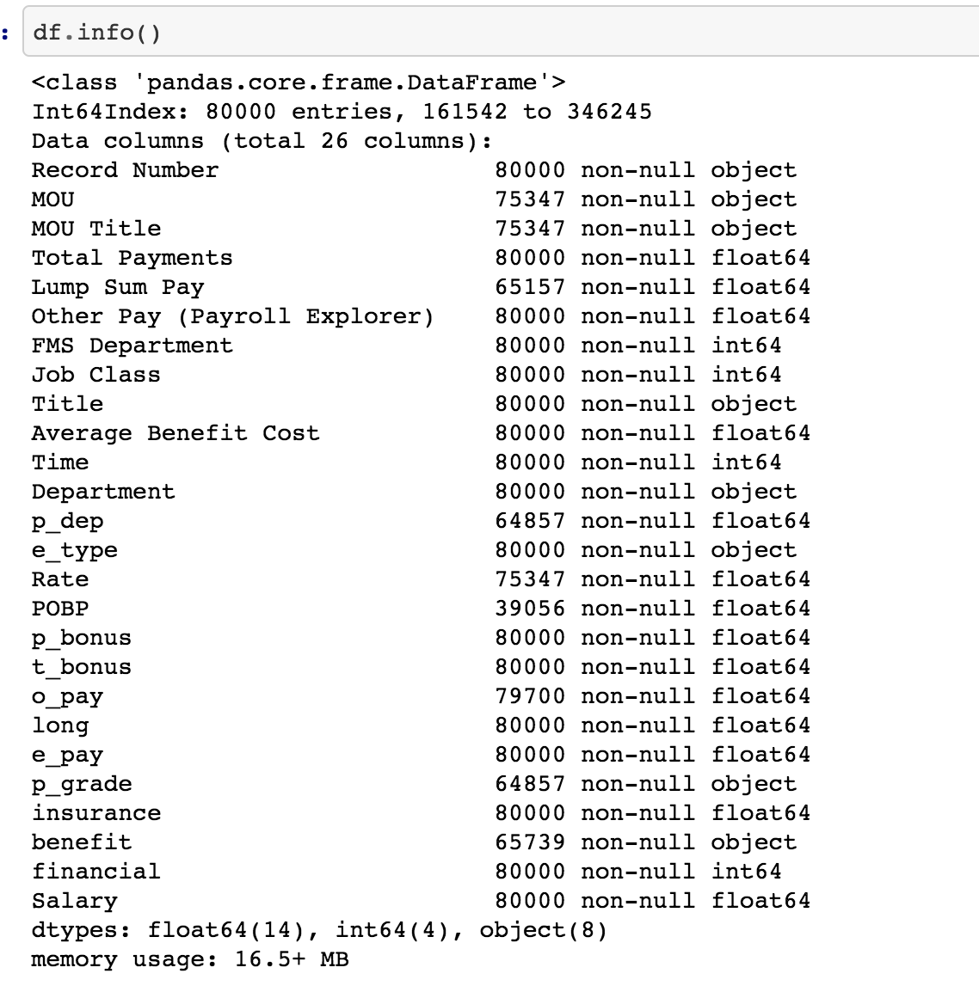
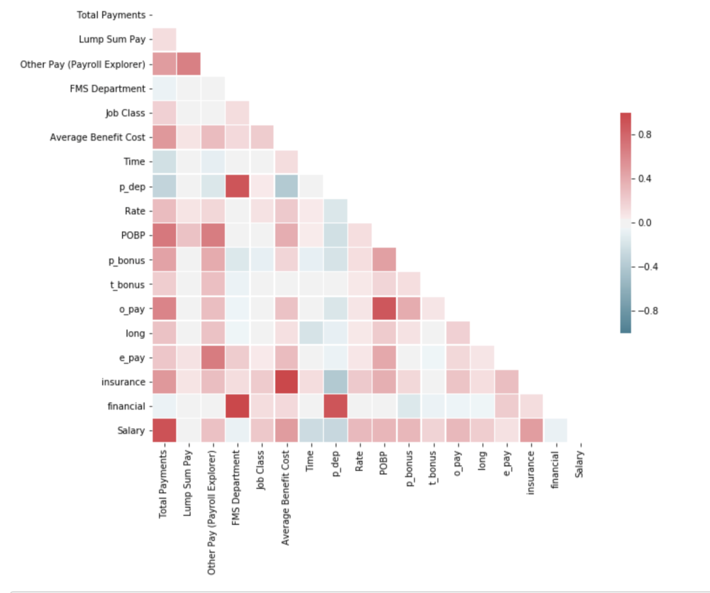
Exploratory Data Analysis

Slide 4
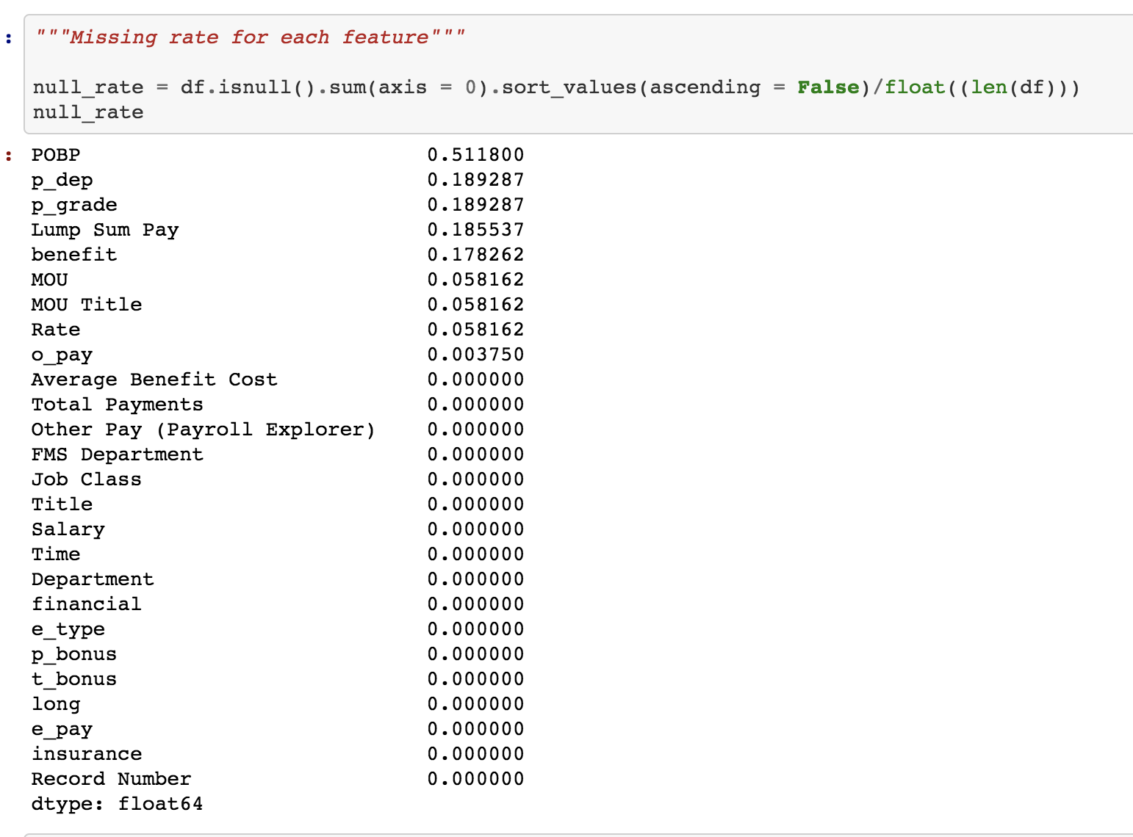
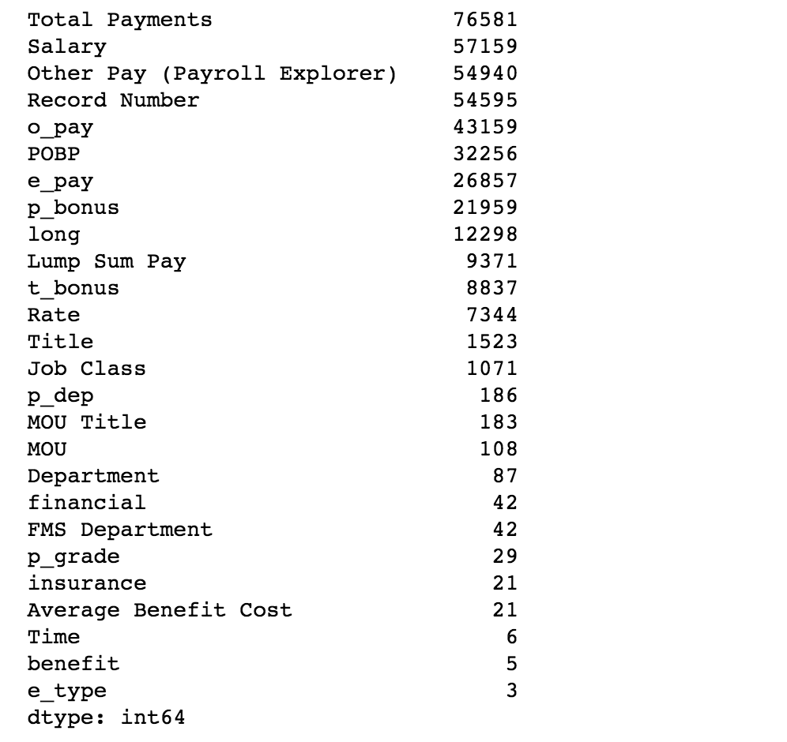
Missing rate for each feature/column
Unique rate for each feature

Slide 5
Data Preprocessing
Remove unnecessary features:
MOU
MOU Title
Title
Department
Record Number
POBP (>50% missing)
Simple data imputation:
P_dep: mean
Rate: mean
O_pay: median
Benefit: impute as “-1”
P_grade: impute as “-1”
Lum sum pay: impute as “0”
Save preprocessed data to pickle file

Slide 6
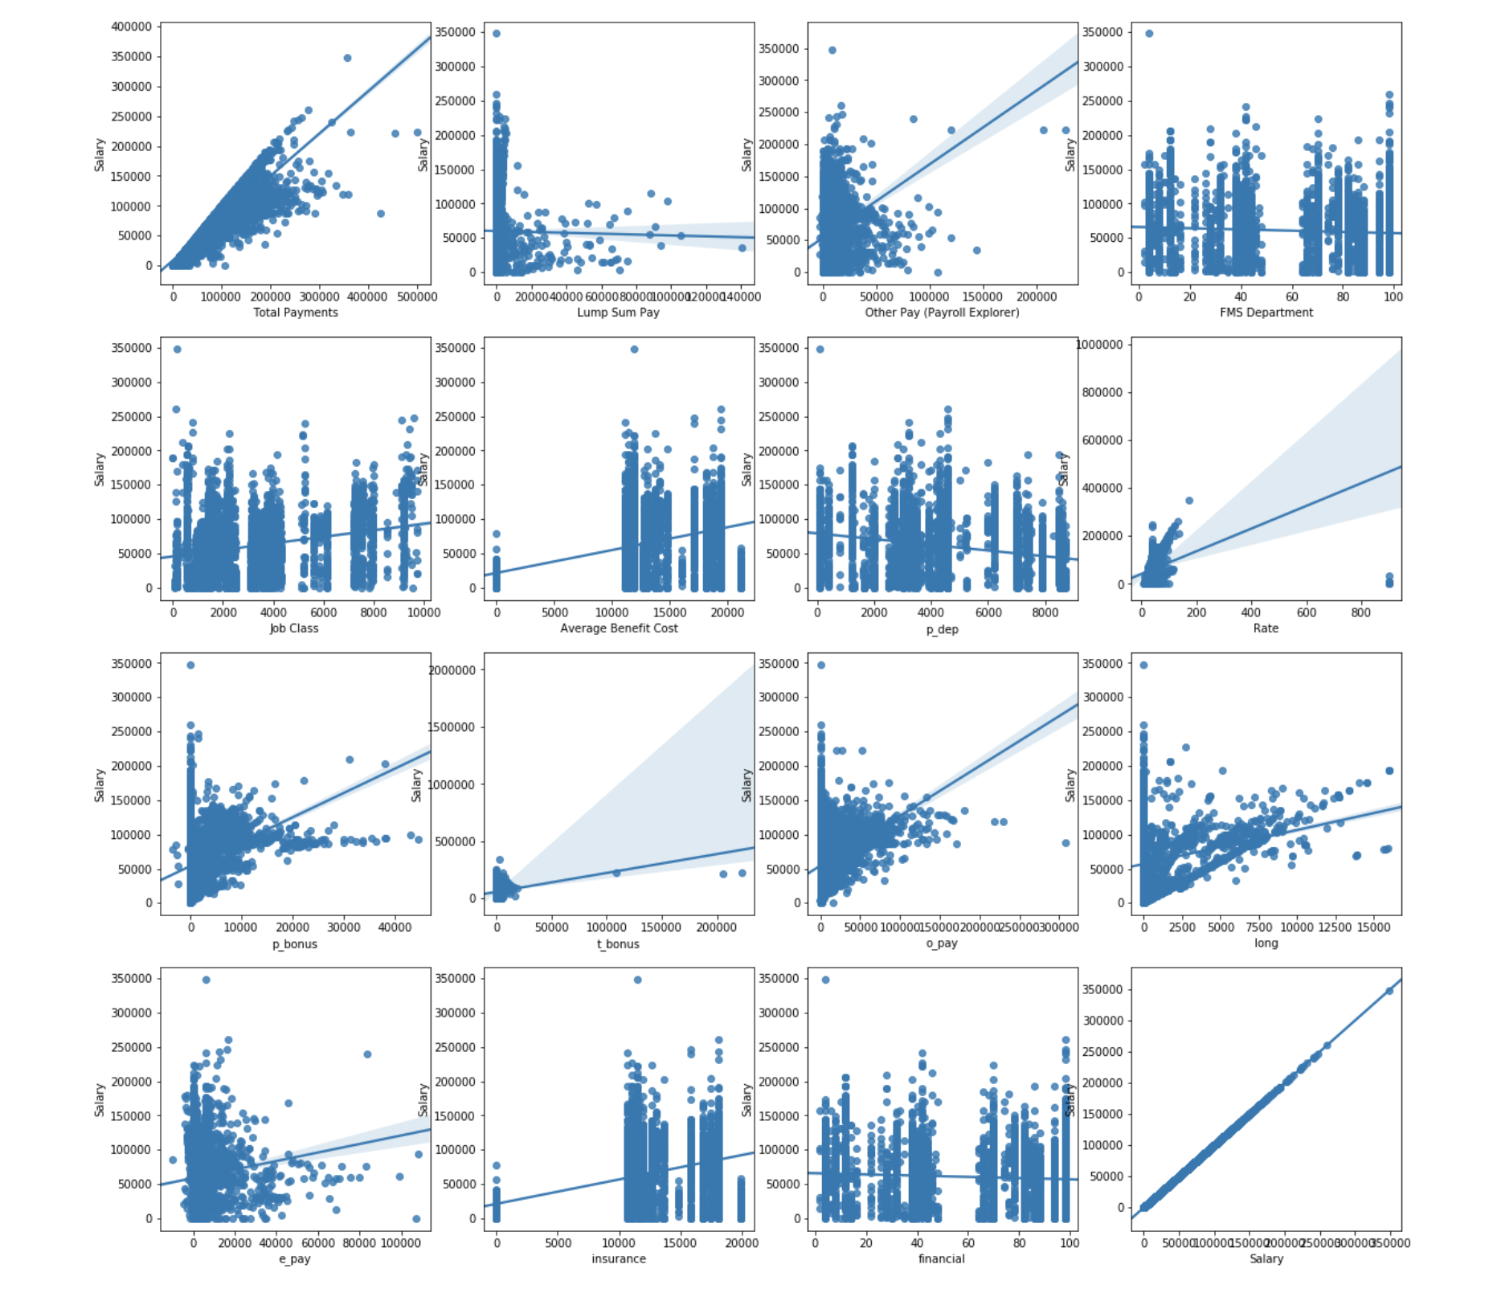
Scatterplots for numerical features after imputation

Slide 7
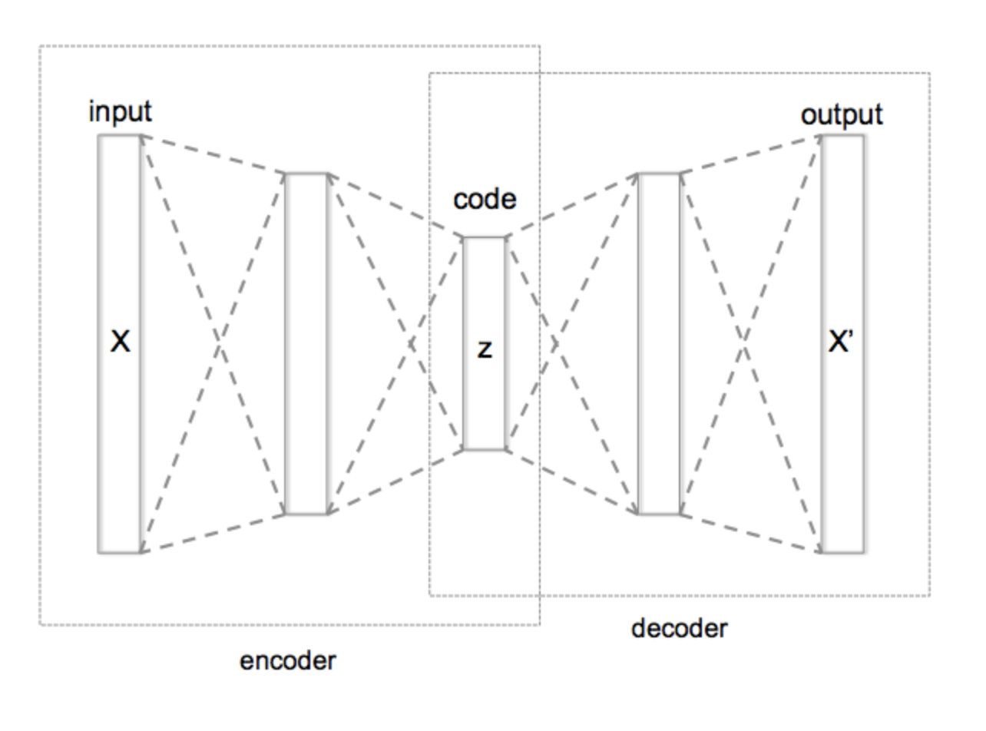
Data synthesis: Autoencoder!

